Slide 1


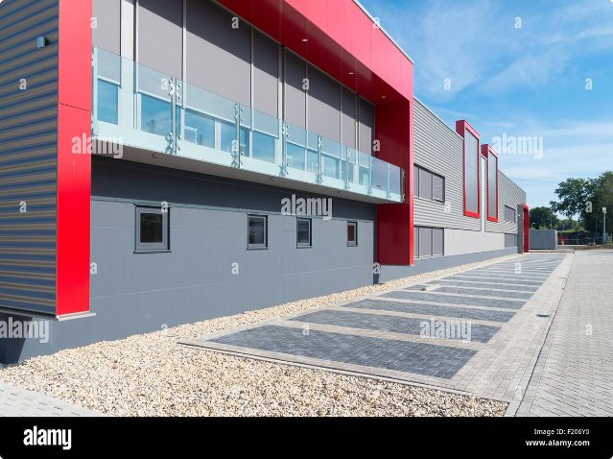

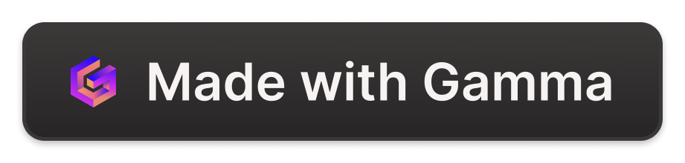
Introduction to Supply Chain Management
Supply chain management (SCM) encompasses the planning, execution, and control of all activities involved in sourcing, producing, and delivering goods or services to end customers. It is a complex system that involves multiple stakeholders, including suppliers, manufacturers, distributors, and retailers.
by Harsh Vardhan Singh

Slide 2
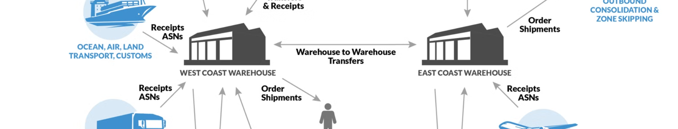
Key Components of a Supply Chain
1
Sourcing
2
Production
Identifying and selecting suppliers for raw materials and components.
Transforming raw materials into finished goods.
3
Distribution
4
Customer Service
Moving products from manufacturing facilities to warehouses and ultimately to customers.
Providing support and handling customer inquiries and complaints.

Slide 3
Importance of Effective Supply Chain Management
Cost Reduction
Improved Customer Satisfaction
Enhanced Efficiency
Optimizing logistics and inventory management can lead to significant cost savings.
Streamlining processes and reducing waste throughout the supply chain.
Meeting customer demands on time and with high-quality products.

Slide 4

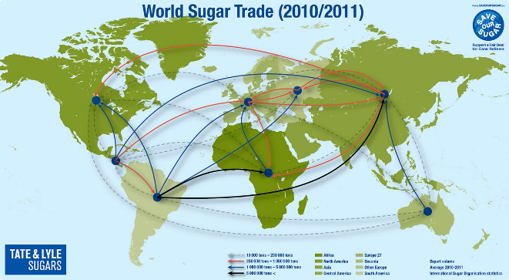
Challenges in Supply Chain Management
1
Global Volatility
Geopolitical events, natural disasters, and economic fluctuations.
2
Technological Advancements
Staying ahead of rapid technological changes in automation and logistics.
3
Environmental Sustainability
Balancing economic efficiency with environmental responsibility.
4
Talent Acquisition
Finding and retaining skilled professionals in a competitive job market.

Slide 5

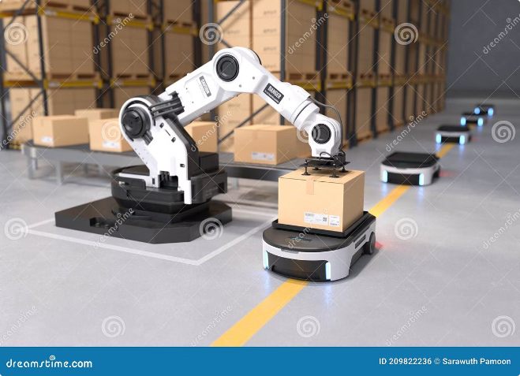
Technology and Supply Chain Optimization
Big Data Analytics
Gaining insights from vast amounts of data to identify trends and make better decisions.
Internet of Things (IoT)
Real-time tracking of inventory and assets throughout the supply chain.
Cloud Computing
Storing and accessing data securely and remotely.
Artificial Intelligence (AI)
Automating tasks, optimizing routes, and improving forecasting accuracy.

Slide 6

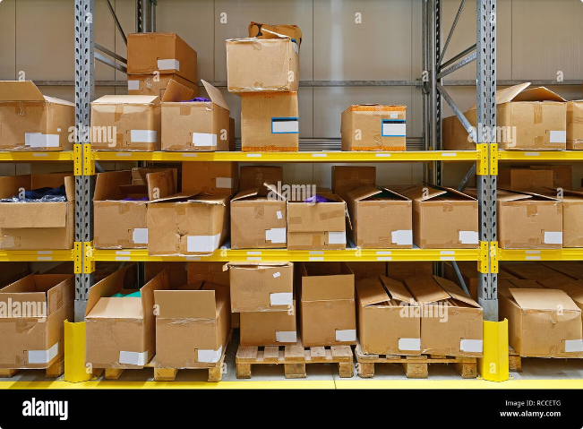
Inventory Management Strategies
Strategy
Description
Just-in-Time (JIT)
Minimizing inventory levels by receiving materials only when needed.
Materials Requirements Planning (MRP)
Planning and scheduling production and purchasing based on demand forecasts.
Safety Stock
Maintaining a buffer of inventory to prevent stockouts during unexpected demand fluctuations.

Slide 7

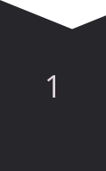

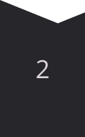
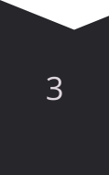
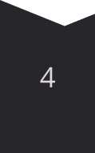
Supplier Relationship and Collaboration
Vendor Selection
Evaluating and choosing reliable suppliers who meet quality standards.
Contract Negotiation
Establishing clear terms and conditions for partnerships.
Performance Monitoring
Tracking supplier performance and addressing any issues promptly.
Collaboration
Open communication and information sharing to improve efficiency and innovation.

Slide 8
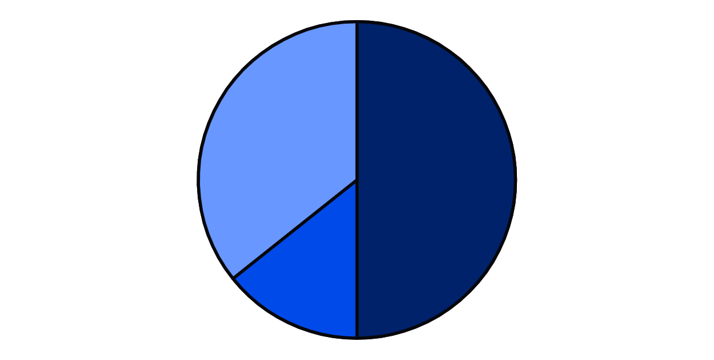
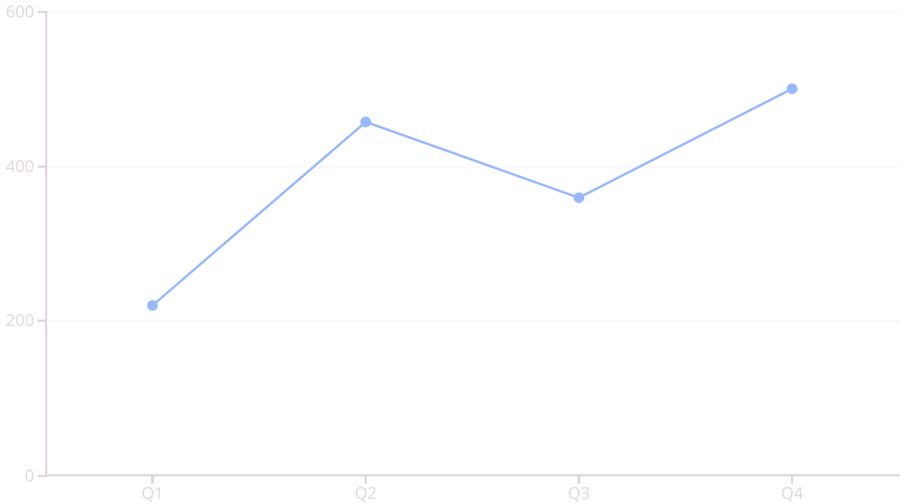
Land transprot
Air transport
Water transport

Slide 9






Continuous Improvement in Supply Chain
Data-Driven Insights
Utilizing data to identify areas for improvement.
Process Optimization
Streamlining workflows and eliminating inefficiencies.
Technological Adoption
Embracing new technologies to enhance capabilities.
Cross-Functional Collaboration
Fostering cooperation among different departments and stakeholders.

